Slide 1
Term Sheets – What to look out for
Nicola McGrath | Partner | Eugene F. Collins
InterTradeIreland - Venture Capital Conference 2019
7 March 2019

Slide 2
Term Sheets – What to look out for
What?
Why?
Who?
Key terms?

Slide 3
Term Sheets – Key Terms
Type
Dilution
Governance
Promoter Obligations

Slide 4
What?
Definition A term sheet
is a bullet-point document outlining the material terms and conditions of a business agreement.
After a term sheet has been "executed", it guides legal counsel in the preparation of a proposed "final agreement".
It then guides, but is not necessarily binding, as the signatories negotiate, usually with legal counsel, the final terms of their agreement.
Source: Wikipedia

Slide 5
Why?
Key points – get agreement upfront
Road map – basis for legal documents
Moral Force!

Slide 6
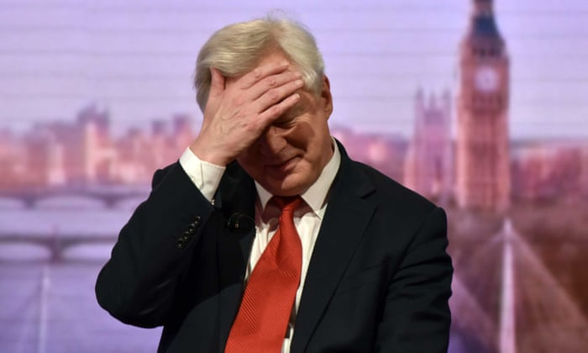
David Davis scrambles to salvage EU relations after 'damaging trust'
Source: Guardian 12 December 2017
Brexit secretary moves to persuade Guy Verhofstadt that UK can be trusted after claiming deal to progress talks was just ‘statement of intent’

Slide 7



Who?
Company
Promoters
Investors
Notes:
To carry out a Dawn Raid the CCPC needs to obtain a valid Search Warrant from a District Court Judge.
The District Court Judge may issue a Search Warrant if it is satisfied by information on oath of an Authorised Officer that there are reasonable grounds for suspecting that evidence of or relating to the commission of an offence under the Competition Act 2002 is to be found.
Authorised officers of the CCPC have to set out the basis for their application to the District Court Judge in a written document known as a Sworn Information.
Lawyers advising a business subjected to a dawn raid should seek a copy of the search warrant and sworn information at the earliest possible opportunity.
Search Warrants must contain details of the statutory power under which they have issued and the statutory preconditions for their issue and the fact that those statutory preconditions have been satisfied.
It’s important to review the search warrant to determine what its scope is and whether it is lawful. In the 2005 case of The Competition Authority v The Irish Dental Association the Search Warrant used by the Competition Authority was illegal because it misidentified the activity of the Irish Dental Association.
It purported to allow authorised officers to enter the premises to search those premises by means of which any activity in connection with the business of selling, supplying or distributing motor vehicles is carried on.
Copy and Paste Job.

Slide 8



Key Terms
What is the first thing that people look for?
 | Promoter: Valuation
 | Lawyer: Non binding clause & the legally binding stuff
 | It’s Commercial!

Slide 9



Key Terms – Type of Security
ORDINARY SHARES
CONVERTIBLE PREFERENCE SHARES
Fixed Preference
Participating Preference
Ordinary Shares
Preferences Shares
Fixed preference
Participating preference
CONVERTIBLE LOAN NOTES
Secured/Unsecured
Convertible loan notes
Secured/unsecured

Slide 10

Key Terms – Dilution
Initial Valuation
Anti-dilution protection
ESOP
Pre-emption on new issue/right of first refusal
Cap Table

Slide 11
Key Terms - Governance
Board Seat
Investor Majority
Information Rights
Restricted Transactions

Slide 12


Key Terms – Promoter obligations
“Reverse vesting”
Restriction on transfers
Personal holding company/tax structuring?
Drag along/tag along
Restrictive covenants
Reps and warranties

Slide 13





Contact
 | Nicola McGrath Partner, Corporate T +353 1 202 6459 E nmcgrath@efc.ie
 | John Olden Partner, Corporate T +353 1 202 6411 E jolden@efc.ie
 | Doreen Mescal Solicitor, Corporate T +353 1 202 6563 E dmescal@efc.ie
 | Catherine Cusack Solicitor, Corporate T +353 1 202 6426 E ccusack@efc.ie
 | Jack Lehane Solicitor, Corporate T +353 1 202 6459 E jlehane@efc.ie

Slide 14


